Slide 1
A Novel Method for Handwritten Digit Recognition
Team Members:
Harieesh Rakhavandaran .N.A
Praneshver.P
Sathish kumar.S
Vengateshkumar.M
Project Mentor :
G.Yuvaraj,M.E.
Department of Computer Science and Engineering
Velammal Institute of Technology

Slide 2
Contents
Problem definition
Architecture of the application
Hardware & Software Requirements
Existing Application
Objective
Advantages
Disadvantages
Department of Computer Science and Engineering
Velammal Institute of Technology

Slide 3
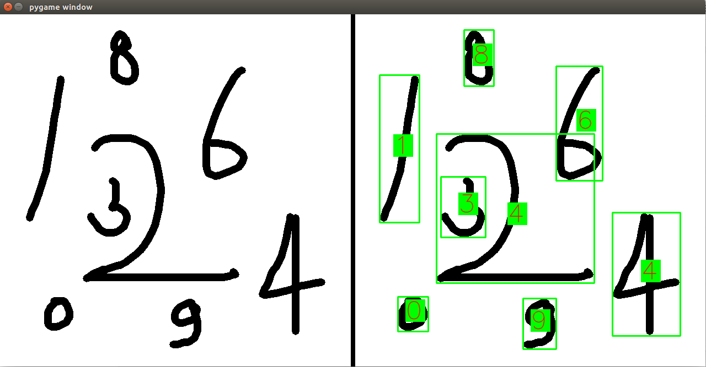
Problem definition
Handwritten character recognition (HCR) is the process of conversion of handwritten text into machine readable form.
The major problem in HCR system is the variation of the handwriting styles, which can be completely different for different writers.
Department of Computer Science and Engineering
Velammal Institute of Technology

Slide 4
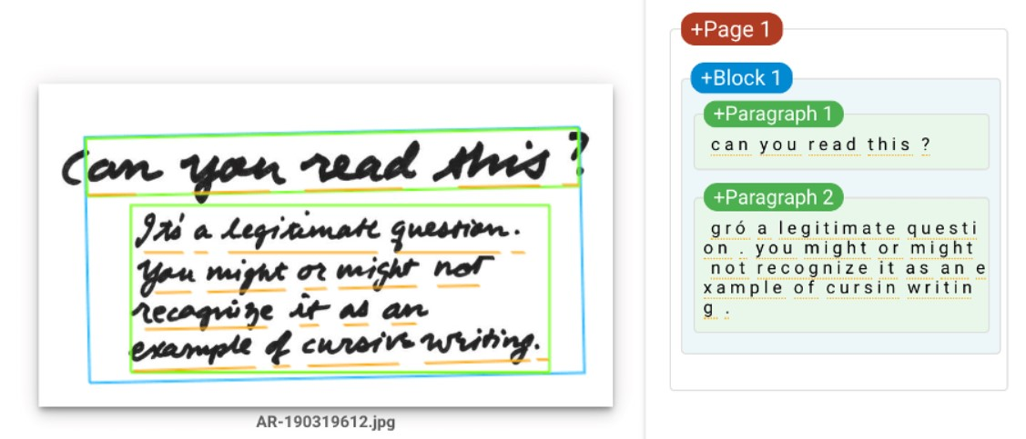
The objective of handwritten character recognition system is to implement user friendly computer assisted character representation that will allow successful extraction of characters from handwritten documents and to digitalize and translate the handwritten text into machine readable text.
Department of Computer Science and Engineering
Velammal Institute of Technology

Slide 5
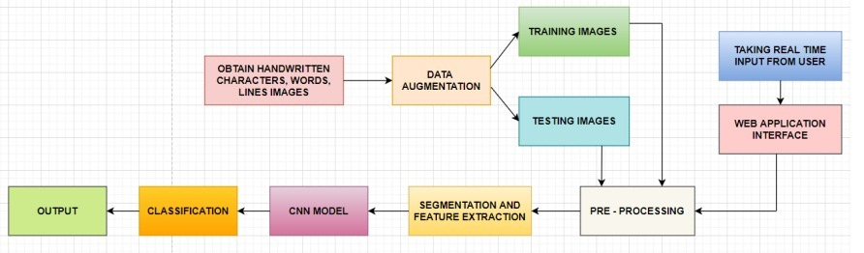
Architecture of the Application
Department of Computer Science and Engineering
Velammal institute of Technology

Slide 6
Architecture of the Application
1. Image Acquisition: The input image is sent to the recognition system during the image acquisition stage. The input can be in the form of an image(JPEG, PNG, etc. ), a scanned picture, a digital camera, or any other acceptable digital input device.
2. Data Augmentation: The dataset is divided into two parts where 80% is used for training and 20% is used for testing. To boost the efficiency of the model, the diversity in the data is artificially boosted using Data Augmentation. By rotating the images of the dataset to form images with different angles.
3. Splitting of dataset: The dataset is splitted into two parts that are testing and training. 80% of the dataset is used for training and 20% for testing.
4. Preprocessing: Pre-processing is the first step in character recognition and is crucial in determining the recognition rate. Preprocessing helps to normalise the strokes and remove any variations that could slow down the accuracy rate. The major focus of preprocessing is on numerous distortions such as irregular text size, points lost during pen movement, jitters, left-right bend, and uneven spacing. Noise reduction, binarization, and normalizing are all part of the process.
Department of Computer Science and Engineering
Velammal Institute of Technology

Slide 7
Architecture of the Application
6.Segmentation: Segmentation is a technique for breaking down a large input image into individual characters. Word, line, and character segmentation are the approaches employed. It's usually done by separating single characters from a word graphic.
7. Feature Extraction: Deep learning itself extracts features with deep neural networks and classifies itself. Compared to traditional algorithms its performance increases with increase in dataset.
8. Classification: CNN is used to classify the image based on its features and along with the trained dataset. The Handwritten Character Recognition recognizes an image when it is given as an input, its important features are extracted and is provided as an input to the CNN classifier. It compares the featured image with the trained dataset and classifies the image with higher accuracy.
9. Taking real time user input: Now the model is used to recognise real time characters written by the user. Users need to write on paper and upload the scanned copy of the same to predict the text written by them.
10. Output: The output specifying what was written in the input image is obtained.
Department of Computer Science and Engineering
Velammal Institute of Technology

Slide 8
Hardware Requirements:
● Processor : Intel Core i5
● HDD: 1TB
● RAM: Minimum 2GB; Recommended 4GB
Software Requirements:
● Operating system : Windows 10
● Dataset: IAM Dataset(Words, Lines)
● Programming Language: Python
● Numpy : Core package providing powerful tools to manipulate data arrays, such as our character images.
● OpenCV : OpenCV is a large open-source library for image processing, character recognition, and machine learning. It canscan handwritten images.
● Autocorrect : It is used to correct the spelling. It supports many languages.
● Tensorflow : Tensorflow is the core open source library to help you develop and train Machine Learning models.
Department of Computer Science and Engineering
Velammal Institute of Technology

Slide 9
Existing Application
Developed by : Globid
Title : Handwriting Recognizer
Publication website : https://play.google.com/store/apps/details?id=handwriting.to.text.convert
Published Date : 2022
Objective : This handwritten text recognition app “Handwriting Recognizer” can be both used for your personal and professional use. Just scribble the notes and later get them converted to digital text instantly. The app is very easy to use and is designed with an intuitive user interface. Get your own pocket-friendly hand recognizer app and reduce your effort to manually convert your notes into digital text.
Department of Computer Science and Engineering
Velammal Institute of Technology

Slide 10
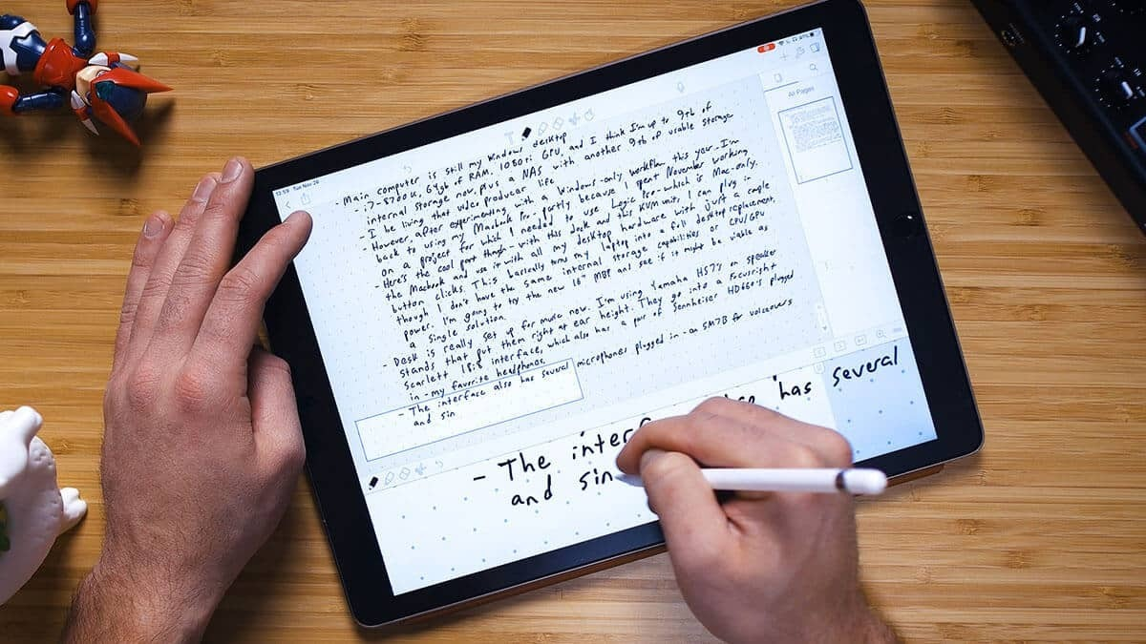
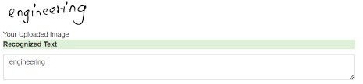
Objective:
Handwriting recognition has gained a lot of attention in the field of pattern recognition and machine learning due to its application in various fields.
Optical Character Recognition(OCR) and Handwritten Character Recognition (HCR) has specific domain to apply. Various techniques have been proposed to for character recognition in handwriting recognition system.
Even though, sufficient studies and papers describes the techniques for converting textual content from a paper document into machine readable form.
In coming days, character recognition system might serve as a key factor to create a paperless environment by digitizing and processing existing paper documents. This paper presents a detailed review in the field of Handwritten Character Recognition
Department of Computer Science and Engineering
Velammal Institute of Technology

Slide 11
Advantages
Quicker processing ; no moving or storage of questionnaires near operators
Savings in costs and efficiencies by not having paper questionaries.
Scanning and recognition allowed efficient management and planning for the rest of the processing workload.
Quick retrieval of our text.
Data is easily read by humans as well as the computer
Department of Computer Science and Engineering
Velammal Institute of Technology

Slide 12
Disadvantages
Poor/untidy handwriting may be difficult to recognize for the system.
Some character could be confused by the system.
Example, 5S ||1
Writing onto the screen takes practices as it not the same “feeling” as paper.
Sometimes recognition is not 100% accurate.
Department of Computer Science and Engineering
Velammal Institute of Technology

Slide 13
THANK YOU
Department of Computer Science and Engineering
Velammal Institute of Technology

